Slide 1
Leadership
Chapter 9 –
Transformational Leadership
Northouse, 5th edition

Slide 2
Overview
Transformational Leadership (TL) Perspective
A Model of Transformational Leadership
Transformational Leadership Factors
Full Range of Leadership Model
The Additive Effects of TL
Other Transformational Leadership Perspectives
How Does the Transformational Approach Work?

Slide 3
Transformational Leadership
Description
Process - TL is a process that changes and transforms individuals
Influence - TL involves an exceptional form of influence that moves
followers to accomplish more than what is usually expected
Core elements - TL is concerned with emotions, values, ethics, standards, and long-term goals
Encompassing approach – TL describes a wide range of leadership influence where followers and leaders are bound together in the transformation process

Slide 4
Types of Leadership Defined
Burns (1978)
Focuses on the
exchanges
that occur
between leaders
and their followers
Process of
engaging with others
to create a connection that increases
motivation and morality in both the leader and the follower
Focuses on the
leader’s
own interests rather than the interests of their followers
TRANSACTIONAL
TRANSFORMATIONAL
PSEUDOTRANSFORMATIONAL

Slide 5
Types of Leadership Defined
Burns (1978)
Focuses on the
exchanges
that occur
between leaders
and their followers
No new taxes = votes.
Sell more cars = bonus.
Turn in assignments = grade.
Surpass goals = promotion.
…
The exchange dimension is so common that you can observe it at all walks of life.
TRANSACTIONAL

Slide 6
Types of Leadership Defined
Burns (1978)
Leaders who are
  transforming but in a negative way
  self-consumed, exploitive, power-oriented, with warped moral values
includes leaders like
  Adolph Hitler
  Saddam Hussein
Focuses on the
leader’s
own interests rather than the interests of their followers
PSEUDOTRANSFORMATIONAL

Slide 7
Types of Leadership Defined
Burns (1978)
Leader is attentive to the needs and motives of followers and tries to help followers reach their fullest potential.
Process of
engaging with others
to create a connection
that increases
motivation
and morality in both the
leader and the follower
Mohandas Gandhi – raised the hopes and demands of millions of his people and in the process was changed himself
TRANSFORMATIONAL

Slide 8
Transformational Leadership & Charisma
Definition
Charisma - A special personality characteristic that gives a person superhuman or exceptional powers and is reserved for a few, is of divine origin, and results in the person being treated as a leader (Weber, 1947)
Charismatic Leadership Theory (House, 1976)
  Charismatic leaders act in unique ways that have specific charismatic effects on their followers

Slide 9
Theory of Charismatic Leadership (House, 1976)

Slide 10
Theory of Charismatic Leadership
(Shamir, House, & Arthur, 1993)
Later Studies
Charismatic Leadership –
  Transforms follower’s self-concepts; tries to link identity of followers to collective identity of the organization
    Forge this link by emphasizing intrinsic rewards & de-emphasizing extrinsic rewards
    Throughout process leaders
      Express high expectations for followers
      help followers gain sense of self-confidence and self-efficacy

Slide 11
Model of Transformational Leadership
Bass (1985)
Transformational Leadership Model
  Expanded and refined version of work done by Burns and House. It included:
    More attention to followers’ rather than leader’s needs
    Suggested TL could apply to outcomes that were not positive
    Described transactional and transformational leadership as a continuum
  Extended House’s work by:
      Giving more attention to emotional elements & origins of charisma
      Suggested charisma is a necessary but not sufficient condition for TL

Slide 12
Model of Transformational Leadership
Bass (1985)
TL motivates followers beyond the expected by:
raising consciousness about the value and importance of specific and idealized goals
transcending self-interest for the good of the team or organization
addressing higher-level needs

Slide 13
Transformational Leadership Factors
Leaders who exhibit TL:
have a strong set of internal values & ideals
are effective in motivating followers to support greater good over self-interest

Slide 14
Full Range of Leadership Model

Slide 15
Transformational Leadership Factors
The 4 “I”s
Idealized Influence
- Acting as strong role models
- High standards of moral and ethical conduct
- Making others want to follow the leader’s vision
Inspirational Motivation
- Communicating high expectations
- Inspiring followers to commitment and engagement in shared
vision
- Using symbols & emotional appeals to focus group members to
achieve more than self-interest

Slide 16
Transformational Leadership Factors
The 4 “I”s
Intellectual Stimulation
- Stimulating followers to be creative and innovative
- Challenging their own beliefs and valuing those of leader and
organization
- Supporting followers to
  try new approaches
  develop innovative ways of dealing with organization issues
Individualized Consideration
- Listening carefully to the needs of followers
- Acting as coaches to assist followers in becoming fully actualized
- Helping followers grow through personal challenges

Slide 17
Transactional Leadership Factors
Contingent Reward
The exchange process between leaders and followers in which effort by followers is exchanged for specified rewards
Management by Exception
Leadership that involves corrective criticism, negative feedback, and negative reinforcement
  Two forms
    Active - Watches follower closely to identify mistakes/rule violations
    Passive - Intervenes only after standards have not been met or problems have arisen

Slide 18
Nonleadership Factor
Laissez-Faire
The absence of leadership
A hands-off, let-things-ride approach
Refers to a leader who
  abdicates responsibility
  delays decisions
  gives no feedback, and
  makes little effort to help followers satisfy their
  needs

Slide 19
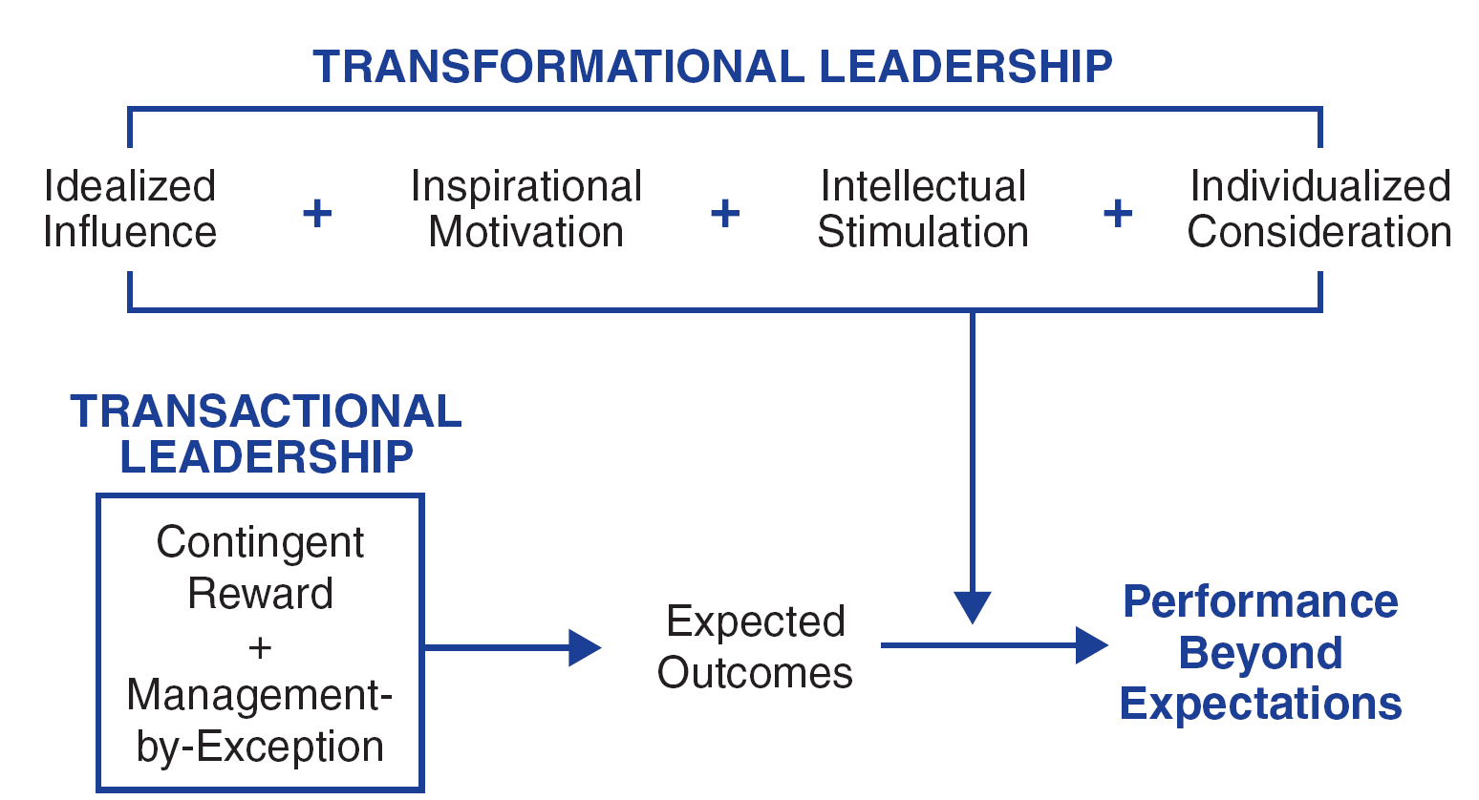
Additive Effect of
Transformational Leadership

Slide 20
Bennis & Nanus (1985)
Four Leader Strategies in Transforming Organizations
Clear vision of organization’s future state
TL’s social architect of organization
Create trust by making their position known and standing by it
Creatively deploy themselves through positive self-regard

Slide 21
Kouzes & Pozner (1987, 2002)
Model consists of 5 fundamental practices
Model the Way
Inspire a Shared Vision
Challenge the Process
Enable Others to Act
Encourage the Heart

Slide 22
How Does the Transformational Leadership Approach Work?
Focus of Transformational Leadership
Strengths
Criticisms
Application

Slide 23
Transformational Leadership
Focus of Transformational Leaders
Overall Scope
TLs empower and nurture followers
TLs stimulate change by becoming strong role models for followers
TLs commonly create a vision
TLs require leaders to become social architects
TLs build trust & foster collaboration
Describes how leaders can initiate, develop, and carry out significant changes in organizations

Slide 24
Strengths
Broadly researched. TL has been widely researched, including a large body of qualitative research centering on prominent leaders and CEOs in major firms.
Intuitive appeal. People are attracted to TL because it makes sense to them.
Process-focused. TL treats leadership as a process occurring between followers and leaders.
Expansive leadership view. TL provides a broader view of leadership that augments other leadership models.
Emphasizes follower. TL emphasizes followers’ needs, values, and morals.
Effectiveness. Evidence supports that TL is an effective form of leadership.

Slide 25
Criticisms
Lacks conceptual clarity
  Dimensions are not clearly delimited
  Parameters of TL overlap with similar conceptualizations of leadership
Measurement questioned
  Validity of MLQ not fully established
  Some transformational factors are not unique solely to the transformational model
TL treats leadership more as a personality trait or predisposition than a behavior that can be taught
TL is elitist and antidemocratic
Suffers from heroic leadership bias
TL is based primarily on qualitative data
Has the potential to be abused

Slide 26
Application
Provides a general way of thinking about leadership that stresses ideals, inspiration, innovations, and individual concerns
Can be taught to individuals at all levels of the organization
Able to positively impact a firm’s performance
May be used as a tool in recruitment, selection, promotion, and training development
Can be used to improve team development, decision-making groups, quality initiatives, and reorganizations
The MLQ helps leaders to target areas of leadership improvement

